Slide 1
Inception and ResNet
October 2017

Slide 2
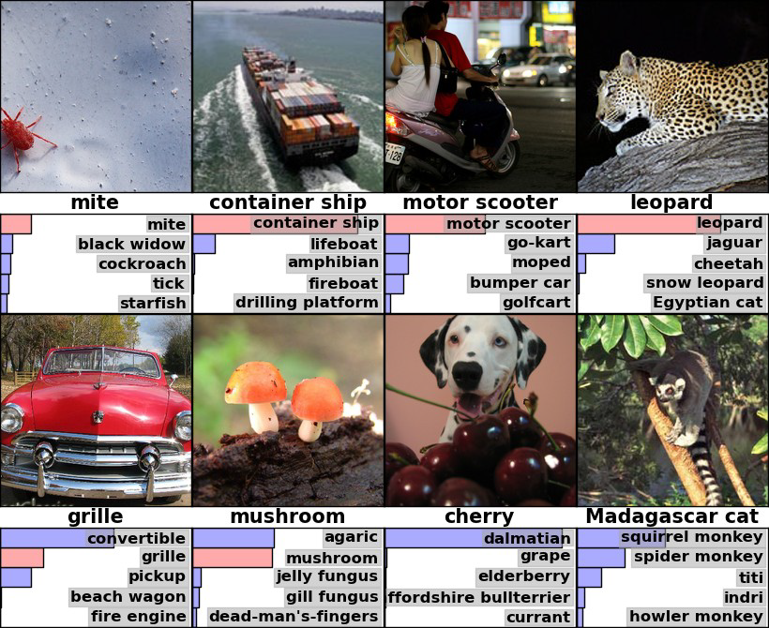
Image Net - Reminder
Classify images into 1000 classes
Human error: 5% - 10%

Slide 3
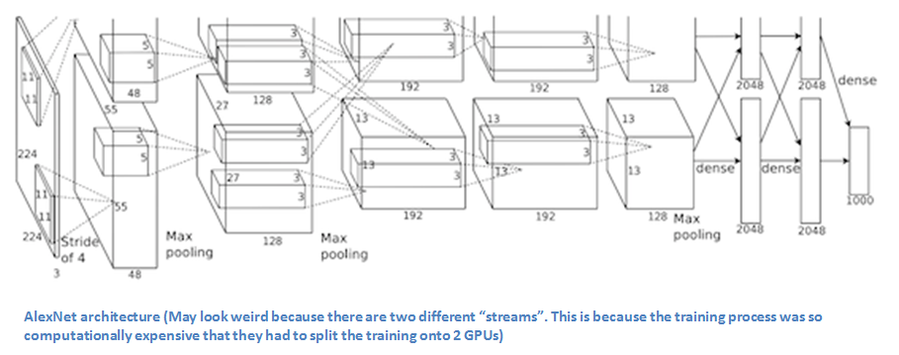
Alex Net
Classify images into 1000 classes
Human error: 5% - 10%
2012 AlexNet (16.2%)
Trained the network on ImageNet data, which contained over 15 million annotated images
Used ReLU for the nonlinearity functions
Used data augmentation
Implemented dropout layers
Trained on two GTX 580 GPUs for five to six days.

Slide 4
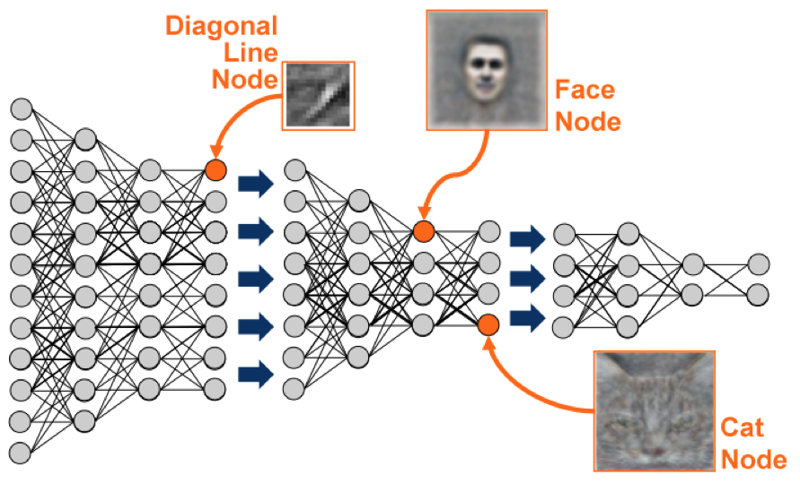
ZF Net
Classify images into 1000 classes
Human error: 5% - 10%
2012 AlexNet (16.2%)
2013 ZF Net (11.2%) (Matthew Zeiler and Rob Fergus )
Very similar architecture to AlexNet,
Trained on only 1.3 million images.
Trained on a GTX 580 GPU for twelve days.
Developed a visualization technique named Deconvolutional Network, which helps to examine different feature activations and their relation to the input space. Called “deconvnet” because it maps features to pixels (the opposite of what a convolutional layer does).

Slide 5
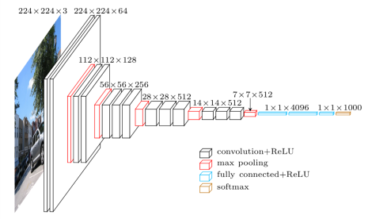
VGG
Classify images into 1000 classes
Human error: 5% - 10%
2012 AlexNet (16.2%)
2013 ZF Net (11.2%)
2014 GoogLeNet (6.7%)
2014 VGG Net (7.3%)
The use of only 3x3 sized filters
Size of input volumes at each layer decrease
They used many layers
Trained on 4 Nvidia Titan Black GPUs for two to three weeks.

Slide 6
1 x 1 convolution

Slide 7
Inception

Slide 8
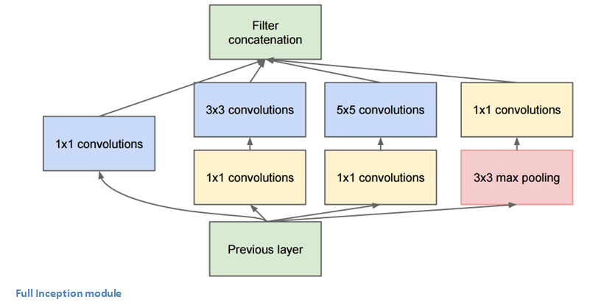
Inception Block

Slide 9
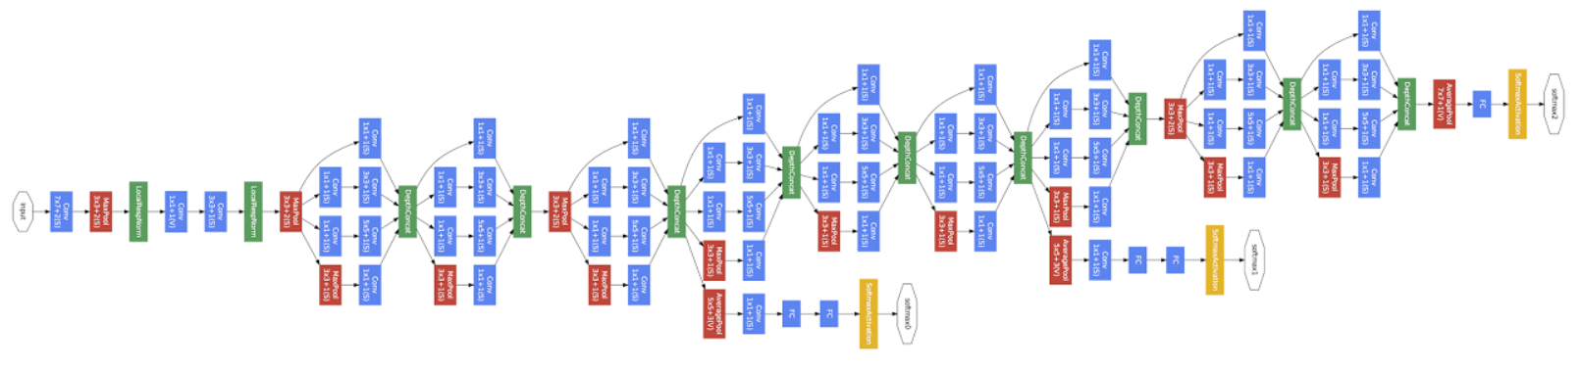
Inception Network

Slide 10
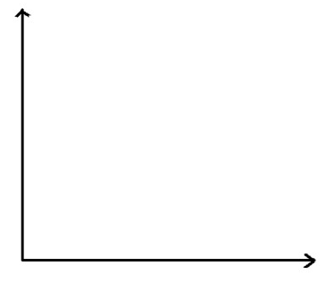
Res Net – problem with depth

Slide 11
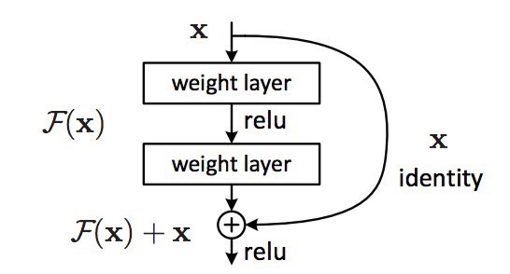
Res Net Block

Slide 12
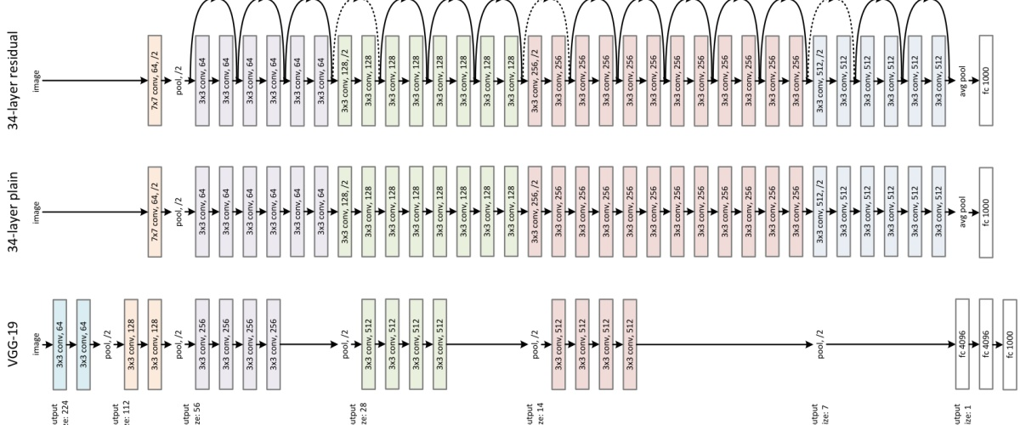
Res Net Idea

Slide 13
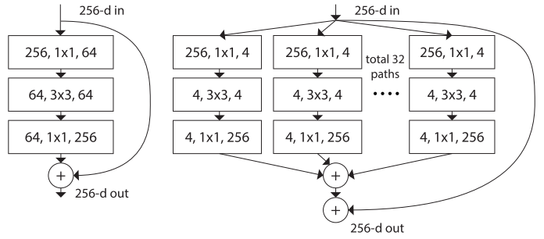
Inception + Res Net

Slide 14
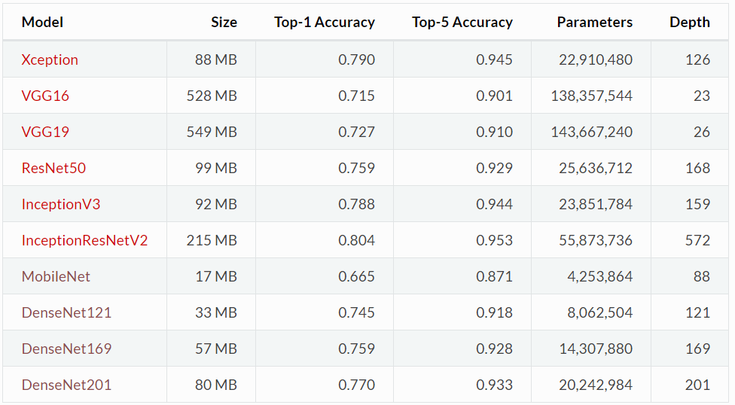
Keras Models

Slide 15
Thank you Q & A

